Slide 1
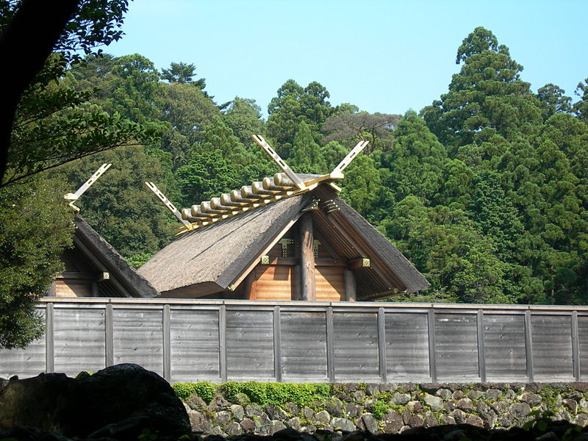
The Yamato “State” and the Early Japanese Imperial Order

Slide 2
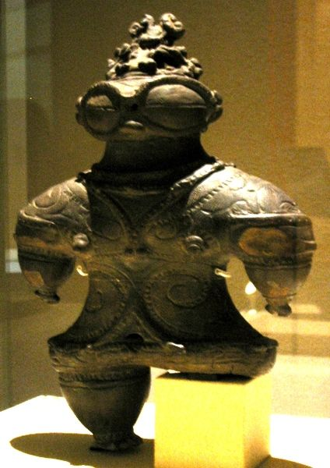
Jōmon culture (earliest times to 3rd century BCE)
Jomon 縄文: a Mesolithic culture with uncertain Ainu or/or Korean origins.
Uji 氏: clans led by patriarch (warrior/shaman).
Wet rice cultivation transform agriculture and settlement patterns

Slide 3
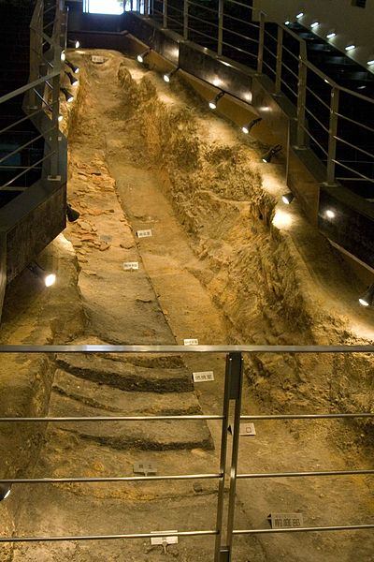
Archeological Links to the Mainland
Until the 8th-century A.D. peoples from Asia were travelling across the Korean region onto the island of Kyushu (Reischauer, p. 10).
Japan’s “cradle of civilization” is said to be in the region of northern Kyushu (Yayoi culture), spreading early on up to the Kanto Plain.

Slide 4
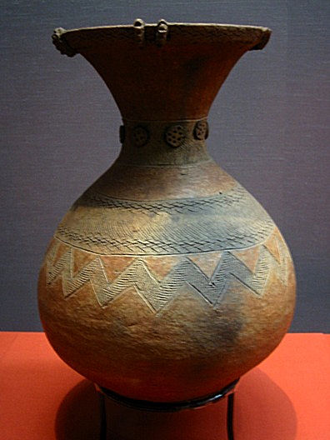
Infusion of Yayoi Culture (ca. 3rd cent. BCE- 300 CE)
Yayoi 弥生 : immigrants to Japan via Korea from the 3rd century BCE; originally from northern China.
Early Yayoi society began the practice of worshipping kami 神, gods that represented forces of nature. Emperors were later considered kami as well.
Yayoi practiced polygamy.
Women could serve as priests.
Iron age began in around 2nd century CE.

Slide 5
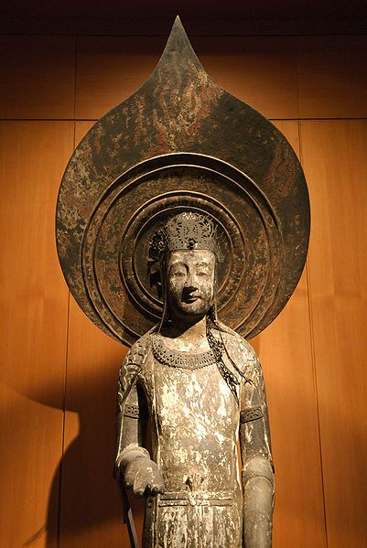
Yamato “State” (ca.550-ca.710)
Confederation of uji, guided by a ruler-led cult of Amaterasu.
Good Relations between Yamato court and Korean Paekche kingdom through 6th-century. Buddhism reached Japan via Korea in 552.
Soga clan eventually took control of the emerging Yamato court and established dynastic line.

Slide 6
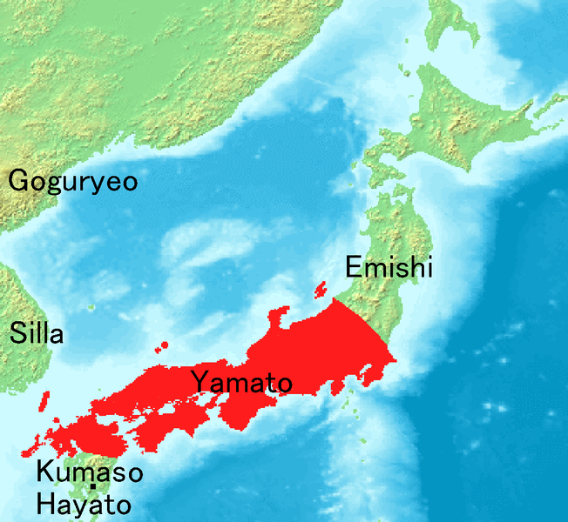
Map of Yamato Control

Slide 7
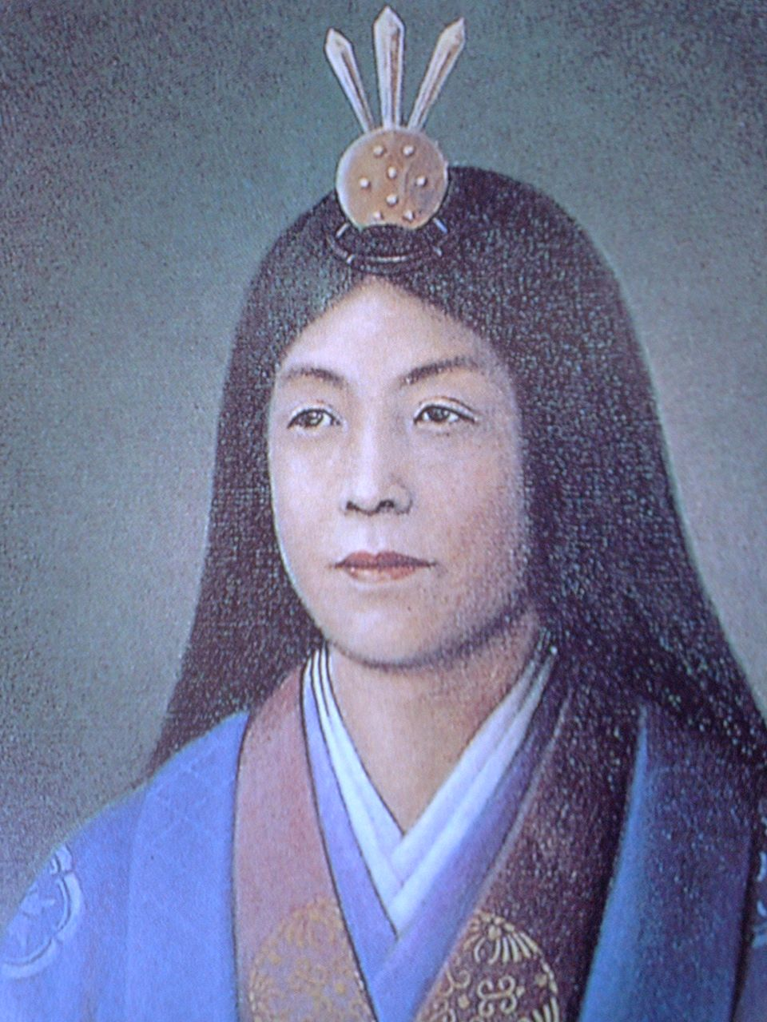
Empress Suiko 推古天皇 (r. 592-628)
First reigning empress in Japan, who took power during the period when China first recognized Japan diplomatically.
The empress sent the first official envoys from Japan to the Chinese Sui court in 607.
Also recognized for ordering the promotion of Buddhism as state religion at court in 594.

Slide 8
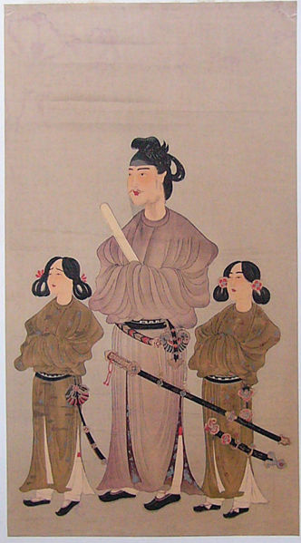
Prince Shotoku 聖徳太子 (573-621)
Regent of Empress Suiko’s court and oversaw the adoption of Chinese institutions. Shotoku has been regarded as the official, who oversaw the creation of The Seventeen-Article Constitution (Kenpo Jushichijo 十七条憲法) (604), although more recent histories credit him only with promoting its main principles.
Confucianism takes hold of court life, beginning in the early 7th century.
Local practices remain strong. Court culture mixes Confucian practices, Shinto beliefs and Buddhism.

Slide 9
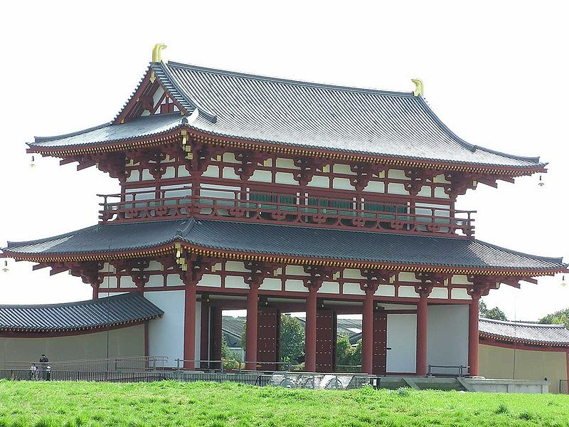
Taika 大化 (645-650) and Nara 奈良(710-794) Periods
Further attempts by Japanese court to adopt Chinese model. Land census and new law and tax codes followed Chinese practices.
Death of Prince Shotoku lead to decline of Soga clan and rise of Fujiwara clan’s 藤原氏 influence at court.
New Nara capital modeled on the Chinese Tang capital at Changan (Xian).

Slide 10
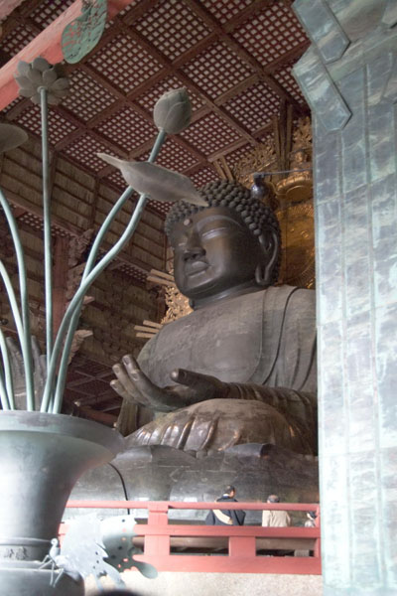
Religious Life at Nara
Tenno 天皇 or "Divine Emperor" derived his authority from two sources; Confucian-influenced Mandate of Heaven and Shinto-guided role as direct descendent of Amaterasu (the Sun Goddess).
Nara marked flowering of Buddhism in Japan; well-connected to court life and the central government.

Slide 11
Heian 平安 Period (794-1185)
Period of peace and stability, capital moved to Heian (Kyoto 京都). The court will remain at Kyoto until the beginning of the Meiji Restoration in 1868.
Continued cultural borrowing from China, even as the Tang dynasty fell into rapid decline.
Fujiwara clan controlled the Heian court for several centuries through intermarriage with the imperial family.

Slide 12
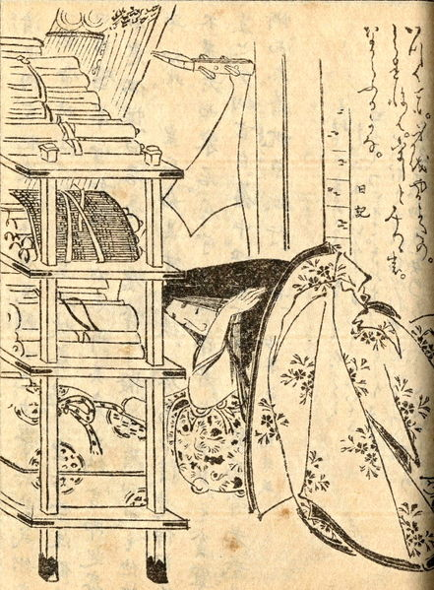
Distinctive Heian court culture
Court culture largely guided by court women; including new writing system (kana, hiragana) separate from written Chinese and worldview based on distinctive Japanese values (often translated as courtliness, sensitivity, and simplicity).
The greatest classic of Japanese literature, the Genji monogatari 源氏物語(Tales of the Genji) by Lady Murasaki Shikibu 紫 式部 (c. 978 - c. 1014), is from this period.

Slide 13
Overall Themes of this Period
Centralized authority comes late to Japan and is never completely implemented.
Period of intense borrowing from China:
Writing system; Chinese characters (kanji 漢字) and Chinese-inspired native system (kanaカナ)
Position of Emperor and court institutions
Buddhism
Confucianism

